Slide 1
Fourier and Laplace Transforms
ECE355L Course Project
Chase Lotito

Slide 2
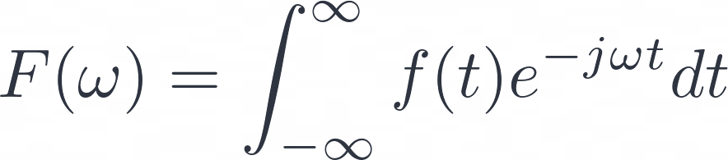
Fourier Transform (F.T.)
The F.T. takes an aperiodic signal f(t) and maps it from the time-domain (t) to the frequency-domain (ω) [1].

Slide 3
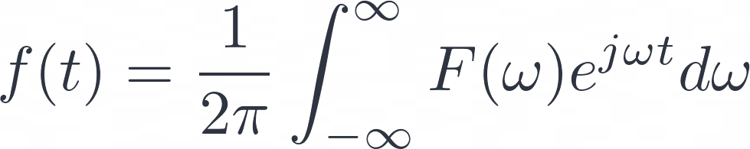
Inverse Fourier Transform
The Inverse of the F.T. lets us take a signal’s frequency spectrum and return it to the original time-domain signal.

Slide 4
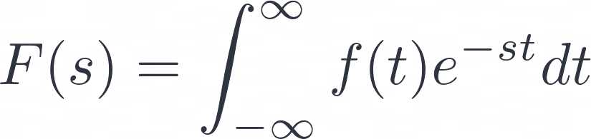

Laplace Transform (L.T.)
The L.T. does the same signal processing from time-domain to frequency-domain, but we generalize to the complex frequency s [1].

Slide 5
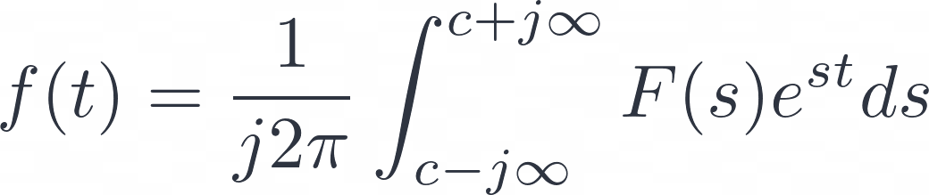
Inverse Laplace Transform
The Inverse of the L.T. similarly, allows us to remap the function from the complex-frequency domain into the real time-domain.

Slide 6
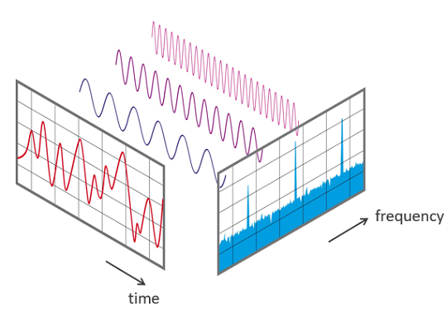
Typical use case of F.T.
Since the Fourier Transform takes the time signal into ω-space…
It is most useful to use the F.T. to analyze the frequency-spectrum.
Seeing the magnitude of the frequency, |F(ω)|, allows us to see how much power is allotted to each frequency.
https://www.nti-audio.com/portals/0/pic/news/FFT-Time-Frequency-View-540.png

Slide 7
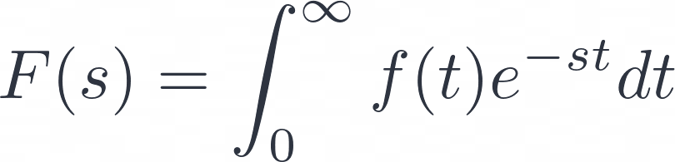

Typical use case of L.T.
Since the Laplace Transform integral is simpler, especially the unilateral-version…
The L.T. can take difficult differential equations and transform them into algebraic equations…
This allows quick solutions to ODEs with initial conditions…
This is especially useful in analyzing the transfer function of a system.
→
→

Slide 8
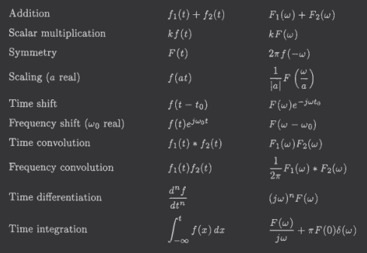
Fourier Transform Properties
From [1].

Slide 9
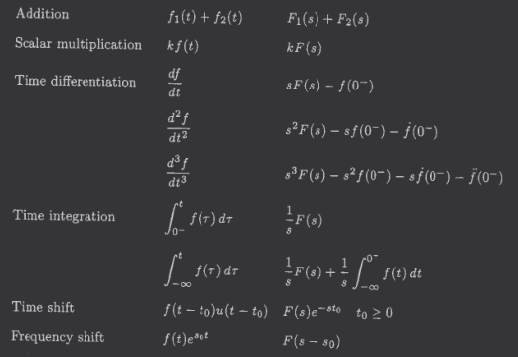
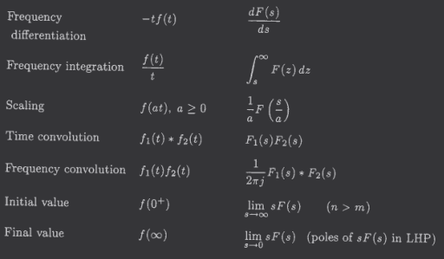
Laplace Transform Properties
From [1].

Slide 10
References
[1] Bhagwandas Pannalal Lathi, Signal Processing and Linear Systems. Oxford University Press, USA, 1998.
‌

